Slide 1

GAP 5503
Engine Construction
Lecture 8
Collision Detection / Resolution
Axis Aligned Bounding Boxes (AABB)

Slide 2
Collisions in Games
Collision programming involves 2 stages
Collision Detection
  Given two moving entities with some given shape / bounds, determine if they intersect
  Detection is a geometric problem
Collision Resolution
  Given that two entities have collided, determine what to do to 'resolve' the physics of the simulation

Slide 3
Assumptions for Slides
We will use the course definition of “Entity”
Assume that Entities have the following:
  Position (x, y)
  Bounding Shape (circle, rectangle, lines)
  Velocity (dx, dy)
Our goal is to learn the mathematics that allows entities to interact in our game

Slide 4

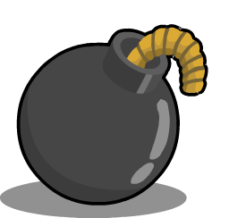
Collision Detection Problems
Given two entities which have a speed, position, and bounding shape, determine if, when, where they will collide (intersect)

Slide 5
Collision Detection Problems
Given two entities which have a speed, position, and bounding shape, determine if, when, where they will collide (intersect)

Slide 6
Collision Detection Problems
Given two entities which have a current position (only), do they intersect? (bool)

Slide 7
Collision Detection Problems
Given two entities which have a current position (only), what is the overlap ? (x, y)
W
H

Slide 8
Entity Bounding Shapes
In the real world, objects can have arbitrary shapes / interaction surfaces
These are difficult to store, compute, and simulate accurately / continuously
All shapes in computer simulations must be made of primitive types
  2D: Line, Triangle, Circle, Rectangle
  3D: Sphere, Plane, Cylinder, Prism
Bounding shape concept: simulate the interaction bounds of a complex shape with a simpler one

Slide 9
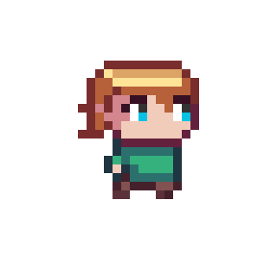
Entity Bounding Shape Example

Slide 10
Entity Bounding Shape Example

Slide 11
2D Bounding Shapes
The simplest 2D bounding shape to store and compute is a circle with given radius
  We have already covered circle intersection
Other 2D bounding shapes can be constructed with a number of line segments
The simplest of these is a rectangle
  Bounding Rectangle / Bounding Box

Slide 12
Bounding Box Size
Most classic 2D games use rectangular sprite graphics
These rectangular images make a natural fit for rectangular bounding box
Usually, the bounding box will be the smallest rectangle that fits the sprite, so we can use the texture size as the bounding box size
However sometimes, this is not the case

Slide 13
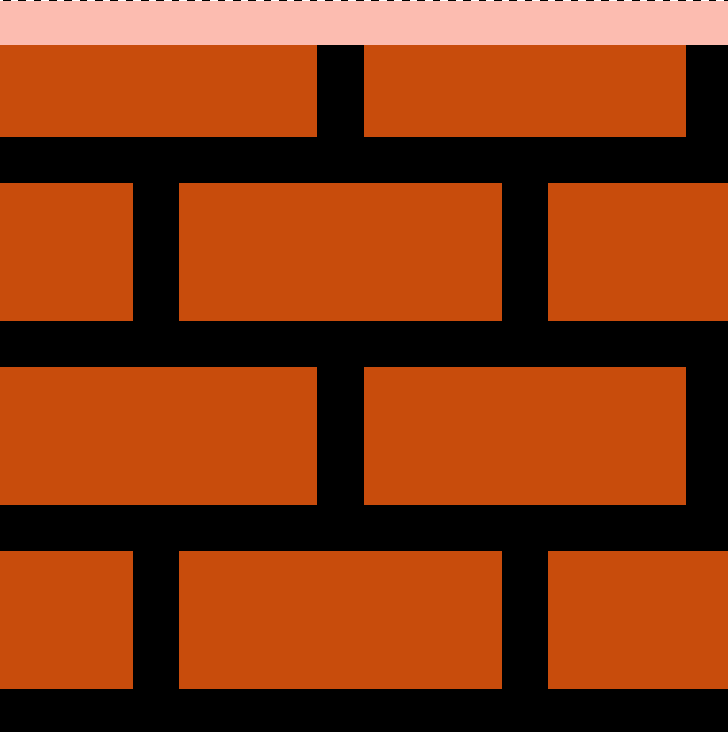

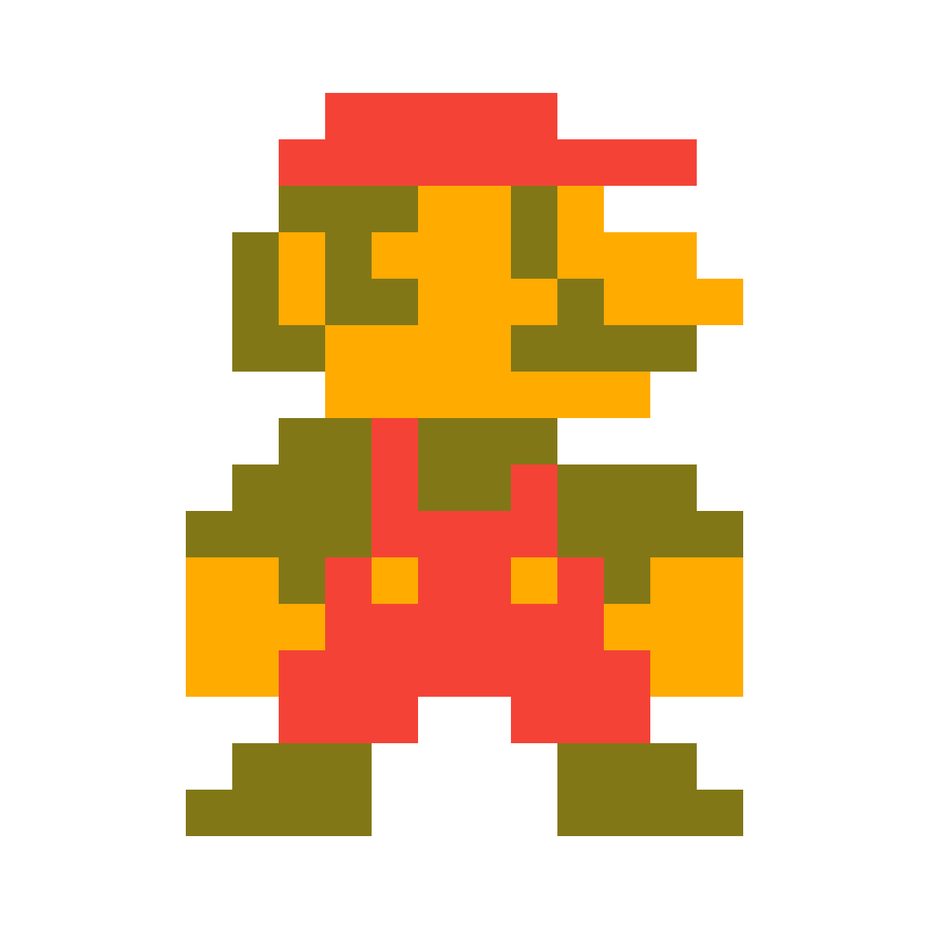
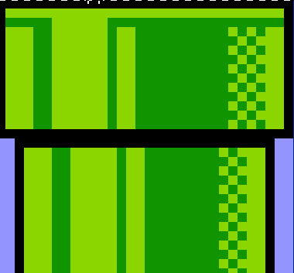
Bounding Box Size

Slide 14



Bounding Box Size
Sometimes the bounding box does not fit the exact bounds of the sprite texture

Slide 15
Bounding Box Size
Sometimes the bounding box does not fit the exact bounds of the sprite texture
So make a custom sized bounding box

Slide 16
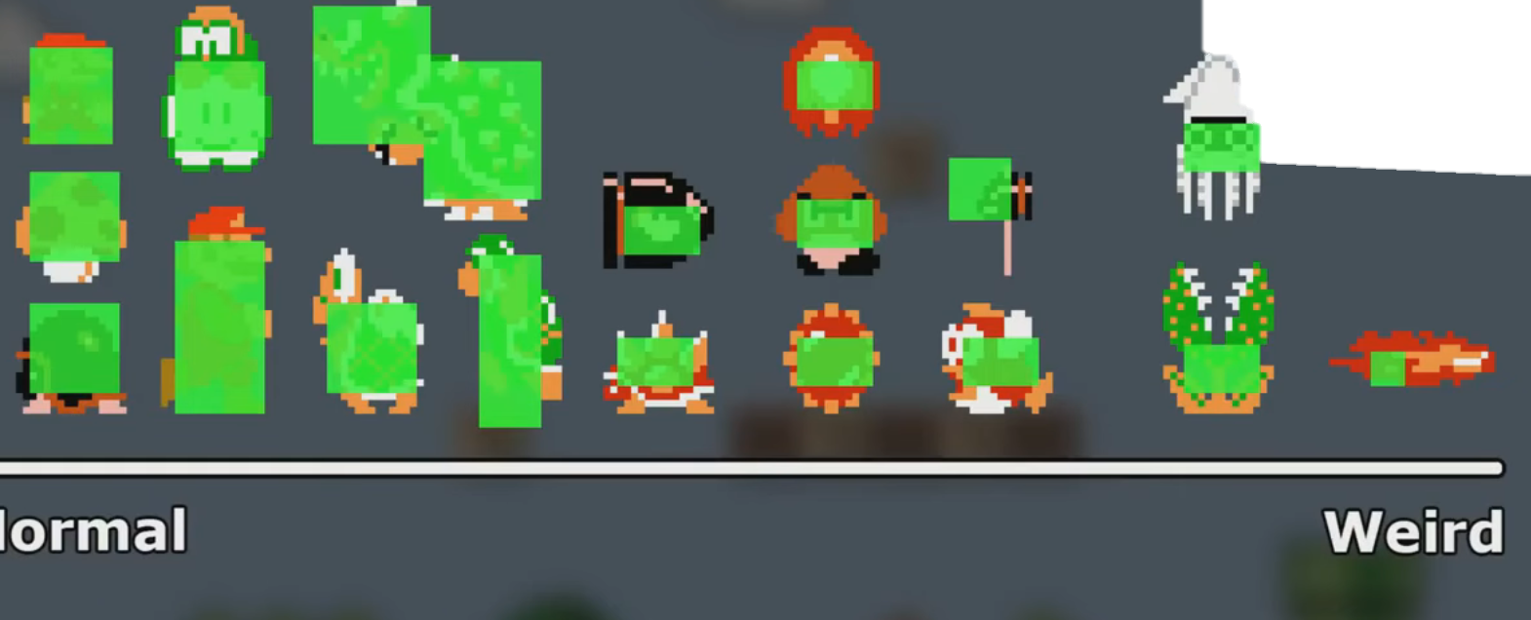

Slide 17
Axis Aligned Bounding Boxes
Rectangles in a 2D plane can take any orientation as long as all 4 corners form 90-degree angles (def of rectangle)

Slide 18
Axis Aligned Bounding Boxes
Detecting intersections of arbitrary rotated rectangles can be quite slow, involving computing if all lines intersect

Slide 19
Axis Aligned Bounding Boxes
By aligning our rectangles with the x / y axis, we can trade arbitrary alignment for very fast intersection / collision checks
Axis Aligned Bounding Box = AABB

Slide 20
Collision DETECTION

Slide 21
Point Inside AABB
The simplest collision check we can do is to see if a single point is inside an AABB
X1, Y1
Px1, Py1
X2, Y2

Slide 22
Point Inside AABB
X1, Y1
P inside if
Px > X1
Px < X2
Py > Y1
Py < Y2
Px, Py
X2, Y2
(0, 0) top-left

Slide 23
Point Inside AABB
X, Y
W
P inside if
Px > X
Px < X + W
Py > Y
Py < Y + H
Px, Py
H
(0, 0) top-left

Slide 24
AABB Intersection
Next step is to determine if two AABB intersect anywhere

Slide 25
AABB Horizontal Overlap
Horizontal overlap occurs if the top of each box is higher than the bottom of the other

Slide 26
X1, Y1
W1
X2, Y2
H1
H2
Horizontal Overlap if
Y1 < Y2 + H2
Y2 < Y1 + H1
W2

Slide 27
AABB Vertical Overlap
Vertical overlap occurs if the left of each box is less than the right of the other

Slide 28
X1, Y1
W1
H1
Vertical Overlap if
X1 < X2 + W2
X2 < X1 + W1
X2, Y2
H2
W2

Slide 29
X1, Y1
W1
H1
X2, Y2
AABB Intersect if
X1 < X2 + W2
X2 < X1 + W1
Y1 < Y2 + H2
Y2 < Y1 + H1
H2
W2

Slide 30
Centered AABB Intersection
Our game engine uses the CENTER of the entity as the position for the AABB
X1, Y1
X1, Y1

Slide 31
Centered AABB Intersection
How do we calculate the overlapping area for center positioned AABB ?
X1, Y1
X1, Y1
Crucial for assignment 3 as we are making Mario Clone

Slide 32
W
X,Y
H

Slide 33
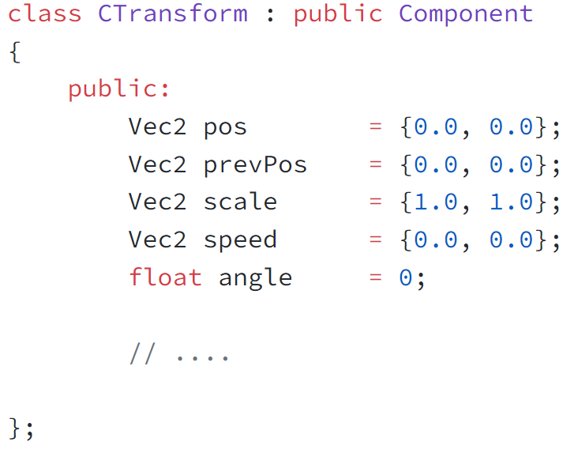
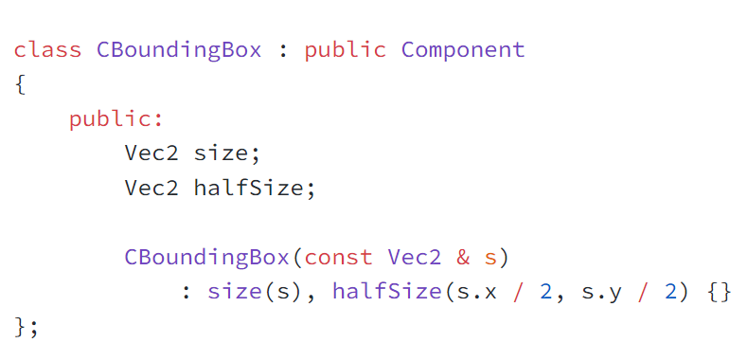
CBBox size.x
CTransform
pos(X,Y)
CBBox size.y

Slide 34
CBBox size.x
CTransform
pos(X,Y)
CBBox size.y

Slide 35
W1
W2
H1
(X1,Y1)
dx
(X2,Y2)
H2
dx = abs(X2 – X1)

Slide 36
W1
W1 / 2
W2
H1
(X1,Y1)
dx
(X2,Y2)
H2
W1 / 2
dx = abs(X2 – X1)

Slide 37
W1 / 2
W2
dx
W1 / 2
dx = abs(X2 – X1)

Slide 38
W1 / 2
W2
dx
Overlap in X-direction
W1 / 2
(W2 / 2) + (W1 / 2) - dx
Positive if X overlap
dx = abs(X2 – X1)

Slide 39
W1
H1
(X1,Y1)
H1 / 2
dy
dy = abs(Y2 – Y1)
W2
H2 / 2
(X2,Y2)
H2

Slide 40
dy = abs(Y2 – Y1)
H2 / 2
dy
H1 / 2

Slide 41
dy = abs(Y2 – Y1)
H2 / 2
dy
Overlap in Y-direction
H1 / 2
(H2 / 2) + (H1 / 2) - dy
Positive if Y overlap

Slide 42
W1
W2
H1
OX
(X1,Y1)
OY
(X2,Y2)
H2
delta = [abs(X1-X2),abs(Y1-Y2)]
OX = (W1/2) + (W2/2) – delta.x;
OY = (H1/2) + (H2/2) – delta.y;
overlap = [OX,OY]

Slide 43
Collision RESOLUTION

Slide 44
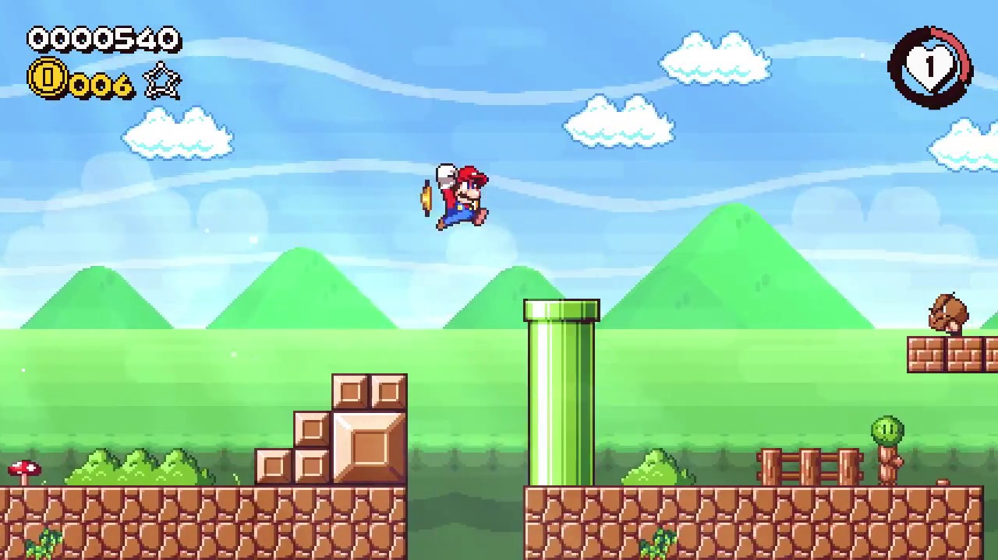
Resolving Collisions
Now that we have detected an AABB collision, what do we do ?
Resolution of collisions depends entirely on what the physics of your world should do
For example: if the player collides with a tile, it should be “pushed out” to no overlap
Show you one way here for assignment 3

Slide 45
Resolving Collisions
Each Frame
Update Positions (physics and math)
Rendering
FRAME 1 - rendering

Slide 46
Resolving Collisions
FRAME 2

Slide 47
Resolving Collisions
FRAME 3

Slide 48
Resolving Collisions
FRAME 4

Slide 49
Resolving Collisions
Collision Detected
Resolution: Green.pos += Overlap
FRAME 5

Slide 50
Resolving Collisions
Both Frame 5
Both happened but user didn’t see it
All the user sees the result, but the collision happened
FRAME 5

Slide 51
Resolving Collisions
FRAME 6

Slide 52
Resolving Collisions
Collision Detected
Resolution: Green.pos += Overlap
FRAME 6

Slide 53
Resolving Collisions
FRAME 7

Slide 54
Resolving Collisions
Collision Detected
Resolution: Green.pos += Overlap
FRAME 7

Slide 55
Tricky Resolution Cases
When we are overlapping at the corners
Collision Detected
What to do ? Have Options

Slide 56
Tricky Resolution Cases

Slide 57
Tricky Resolution Cases

Slide 58
Tricky Resolution Cases

Slide 59
Tricky Resolution Cases

Slide 60
Tricky Resolution Cases
Case 1: Add Overlap
Problem: Bad Physics

Slide 61
Tricky Resolution Cases
Case 2: Move Up Only
Problem: Came from Right

Slide 62
Tricky Resolution Cases
Case 2: Move Right Only
Probably Best “Physics”

Slide 63
Tricky Resolution Cases

Slide 64
Tricky Resolution Cases

Slide 65
Tricky Resolution Cases

Slide 66
Detecting Collision Direction
When detecting collisions in our game, they will first happen on a specific frame
The frame before the collision is detected, there will be no collision
Could try to use overlap to detect which direction the movement came from ?

Slide 67
Tricky Resolution Cases
Use overlap to detect direction of movement ?

Slide 68
Tricky Resolution Cases
Problem: Could have come fast from y direction

Slide 69
Tricky Resolution Cases
Problem: Could have come fast from x direction

Slide 70
Detecting Collision Direction
When detecting collisions in our game, they will first happen on a specific frame
The frame before the collision is detected, there will be no collision
Could try to use overlap to detect which direction the movement came from ?
Use previous overlap to detect direction

Slide 71
Using Previous Overlap
If previous frame overlap.y > 0, then movement came from the side
Resolve collision by pushing in x direction

Slide 72
Using Previous Overlap
If previous frame overlap.x > 0, then movement came from the top or bottom
Resolve collision by pushing in y direction

Slide 73
Top / Bottom Detection
A collision came from the top if it had a previous overlap.x > 0 and its y is higher

Slide 74
Top / Bottom Detection
A collision came from the top if it had a previous overlap.x > 0 and its y is lower

Slide 75
Tricky Resolution Case
What if the previous frame had no overlap in either x or y direction ?
Must decide how to resolve collision based on previous position and / or overlap size

Slide 76
Tricky Resolution Case
What if the previous frame had no overlap in either x or y direction ?
Must decide how to resolve collision based on previous position and / or overlap size

Slide 77
Tricky Resolution Case
What if an entity ovelaps with multiple entities ? Ex: player moving near stack

Slide 78
Tricky Resolution Case
Order of collision checks may decide which resolution occurs, can be tricky

Slide 79
Tricky Resolution Case
The “previous overlap” method discussed here usually resolves this case using previous position only does not

Slide 80
Important Note
All collision resolution discussed here is for the simple case of avoiding overlap
Useful for: walking on tiles, not being able to pass through tiles, bullet hits entity
Many other kinds of collision resolution:
  Kinematic object elastic / inelastic collision
  Physics simulators with mass / forces

Slide 81
Important Note
Super Mario Bros collisions operate slightly differently than presented
Consider the base of Mario jumping on top of an enemy, how is that detected ?
Same AABB overlap is used, however, Mario kills the enemy if he is moving downwards (with x-direction ignored)

Slide 82
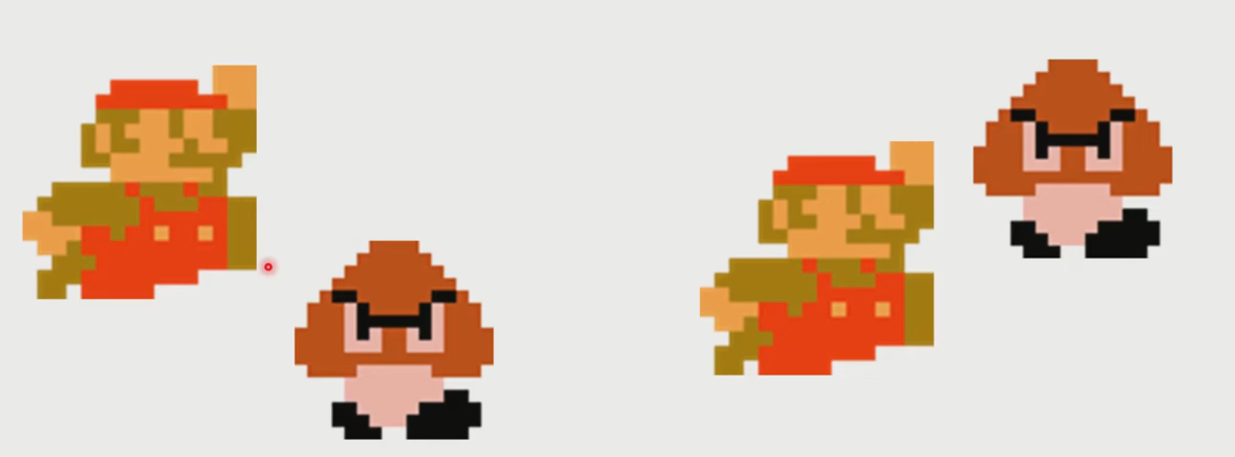
Important Note

